Slide 1

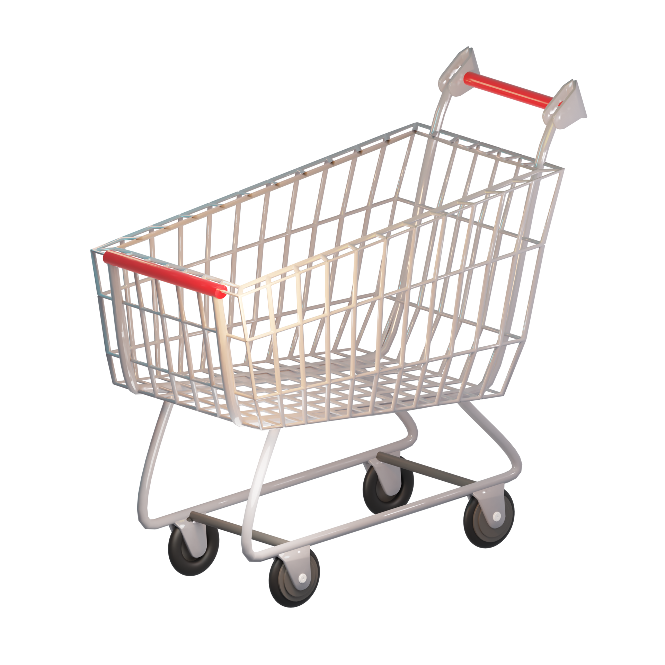

Consumer Goods Ad_Hoc Insights

Slide 2
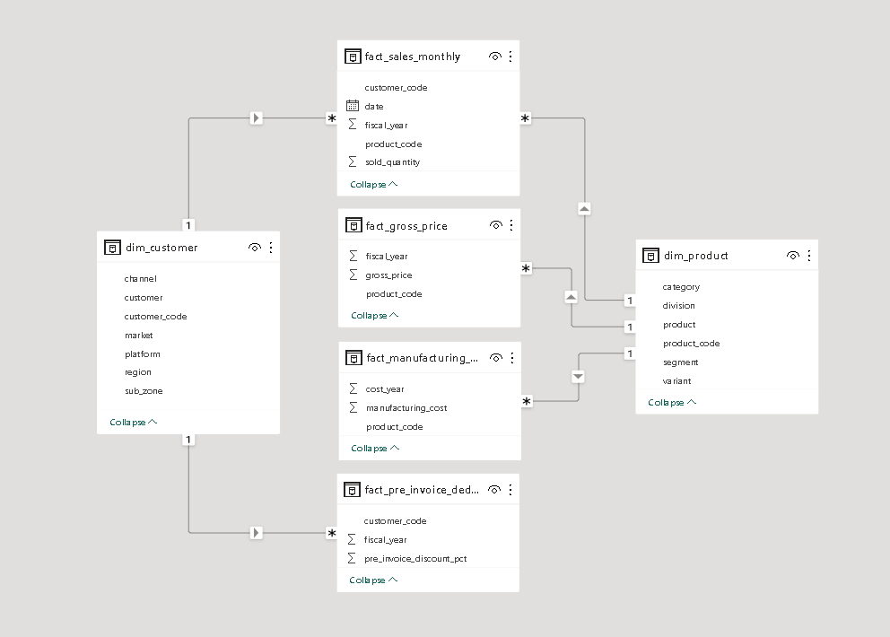
DATA MODEL

Slide 3
Markets operated by ‘Atliq Exclusive’ in APC region
Question 1.
Provide the list of markets in which customer "Atliq Exclusive" operates its business in the APAC region
Output
market
India
Indonesia
Japan
Philiphines
South Korea
Australia
Newzealand
Bangladesh

Slide 4
Percentage Change of unique products (2020 VS 2021)
Question 2.
What is the percentage of unique product increase in 2021 vs. 2020? The final output contains these fields, unique_products_2020 unique_products_2021 percentage_chg
Output
unique_product_2020 | unique_product_2021 | percentage_chg
245 | 334 | 36.3

Slide 5
Number of products in each segment
Question 3.
Provide a report with all the unique product counts for each segment and sort them in descending order of product counts. The final output contains 2 fields, segment product_count
Output
segment | product_count
Notebook | 129
Accessories | 116
Peripherals | 84
Desktop | 32
Storage | 27
Networking | 9

Slide 6
Conversion of output to visual
Insights
Notebook segment is having the highest product count and is approximately 32% of overall unique products in all segments.
From the above visual we can see that for the Networking segment, there are only a few unique products.
Notebook, Accessories, and peripherals account for almost 82 % of overall unique products in all the segments.
segment | product_count
Notebook | 129
Accessories | 116
Peripherals | 84
Desktop | 32
Storage | 27
Networking | 9

Slide 7
Segment with most increase in unique products (2020 vs 2021)
Question 4.
Follow-up: Which segment had the most increase in unique products in2021 vs 2020? The final output contains these fields, segment product_count_2020 product_count_2021 difference
Output
segment | product_count_2020 | product_count_2021 | difference
Accessories | 69 | 103 | 34

Slide 8
Product with the highest and lowest manufacturing cost
Question 5.
Get the products that have the highest and lowest manufacturing costs.The final output should contain these fields, product_code product manufacturing_cost
Output
product_code | product | manufacturing_cost
A0118150101 | AQ Dracula HDD – 3.5 Inch SATA 6 Gb/s 5400 RPM 256 MB Cache | 240.5364
A0118150101 | AQ Dracula HDD – 3.5 Inch SATA 6 Gb/s 5400 RPM 256 MB Cache | 0.892

Slide 9
Top five customers with high average discount in 2021
Question 6.
Generate a report which contains the top 5 customers who received an average high pre_invoice_discount_pct for the fiscal year 2021 and in the Indian market. The final output contains these fields, customer_code, customer, average_discount_percentage
Output
customer_code | customer | average_discount_percentage
90002009 | Flipkart | 0.3083
90002006 | Viveks | 0.3038
90002003 | Ezone | 0.3028
90002002 | Croma | 0.3025
90002016 | Amazon | 0.2933

Slide 10
Conversion of output to visual
customer_code | customer | average_discount_percentage
90002009 | Flipkart | 0.3083
90002006 | Viveks | 0.3038
90002003 | Ezone | 0.3028
90002002 | Croma | 0.3025
90002016 | Amazon | 0.2933
Insights
1. Flipkart is having the highest average discount percentage.

Slide 11
Monthly gross sales amount of “Atliq Exclusive”
Question 7.
Get the complete report of the Gross sales amount for the customer “Atliq Exclusive” for each month. This analysis helps to get an idea of low and high-performing months and take strategic decisions. The final report contains these columns:
month
year
gross sales Amount
Output
month | year | gross_sales_amount
September | 2019 | 9092670.339
October | 2019 | 10378637.6
November | 2019 | 15231894.97
December | 2019 | 9755795.058
January | 2020 | 9584951.939
February | 2020 | 8083995.548
March | 2020 | 766976.4531
April | 2020 | 800071.9543
May | 2020 | 1586964.477
June | 2020 | 3429736.571
July | 2020 | 5151815.402
August | 2020 | 5638281.829
September | 2020 | 19530271.3
October | 2020 | 21016218.21
November | 2020 | 32247289.79
December | 2020 | 20409063.18
January | 2021 | 19570701.71
February | 2021 | 15986603.89
March | 2021 | 19149624.92
April | 2021 | 11483530.3
May | 2021 | 19204309.41
June | 2021 | 15457579.66
July | 2021 | 19044968.82
August | 2021 | 11324548.34

Slide 12
Conversion of output to visual
month | year | gross_sales_amount
September | 2019 | 9092670.339
October | 2019 | 10378637.6
November | 2019 | 15231894.97
December | 2019 | 9755795.058
January | 2020 | 9584951.939
February | 2020 | 8083995.548
March | 2020 | 766976.4531
April | 2020 | 800071.9543
May | 2020 | 1586964.477
June | 2020 | 3429736.571
July | 2020 | 5151815.402
August | 2020 | 5638281.829
September | 2020 | 19530271.3
October | 2020 | 21016218.21
November | 2020 | 32247289.79
December | 2020 | 20409063.18
January | 2021 | 19570701.71
February | 2021 | 15986603.89
March | 2021 | 19149624.92
April | 2021 | 11483530.3
May | 2021 | 19204309.41
June | 2021 | 15457579.66
July | 2021 | 19044968.82
August | 2021 | 11324548.34
Insights
From the line chart we can see that in November 2020 there is the highest gross_sales_amount.
We can also see that for the year 2020 gross_sales amount is increasing gradually and after November it started decreasing.
For 2019 and 2021 it is fluctuating up and down.

Slide 13
Quarter with maximum total sold quantity in year 2020
Question 8.
In which quarter of 2020, got the maximum total_sold_quantity? The final output contains these fields sorted by the total_sold_quantity,
Quarter
total_sold_quantity
Output
quarter | total_sold_quantity
4 | 8425822

Slide 14
Channel with maximum percentage contribution
Question 9.
Which channel helped to bring more gross sales in the fiscal year 2021 and the percentage of contribution? The final output contains these fields,
Channel
gross_sales_mln
Percentage
Output
channel | gross_sales_mln | percentage
Retailer | 1924170398 | 73.2

Slide 15
Top 3 products in each division with high total sold quantity
Question 10.
Get the Top 3 products in each division that have a high total_sold_quantity in the fiscal_year 2021. The final output contains these fields, division ,product_code, product ,total_sold_quantity ,rank_order
Output
division | product_code | product | total_sold_quantity | rank_order
N & S | A6720160103 | AQ Pen Drive 2 IN 1 | 701373 | 1
N & S | A6818160202 | AQ Pen Drive DRC | 688003 | 2
N & S | A6819160203 | AQ Pen Drive DRC | 676245 | 3
P & A | A2319150302 | AQ Gamers Ms | 428498 | 1
P & A | A2520150501 | AQ Maxima Ms | 419865 | 2
P & A | A2520150504 | AQ Maxima Ms | 419471 | 3
PC | A4218110202 | AQ Digit | 17434 | 1
PC | A4319110306 | AQ Velocity | 17280 | 2
PC | A4218110208 | AQ Digit | 17275 | 3

Slide 16
Insights:
For N&S division product AQ Pen Drive 2 IN 1 is having highest total sold quantity.
For P&A division it is product AQ Gamers Ms.
For PC division it is product AQ Digit.
From the output we can also see that N&S division is having highest total sold quantity as compared to other divisions.

